Slide 1


Level One Project Bootcamp Readout
Mojaloop Convening
Kigali November 2024
The Level One Project is an initiative of The Bill & Melinda Gates Foundation
1

Slide 2







Design Principles
Goals
Affordability
Usefulness
Inclusivity
Irrevocability
Open Loop
Fraud mitigation
Cost Recovery + Investment
…
Tools
Mojaloop
Tazama
Attributes
Scale & Ubiquity
Pro-poor governance
Low or no end user fees
Not for loss economics
…
The System
Scheme
Platform
Participants
2

Slide 3
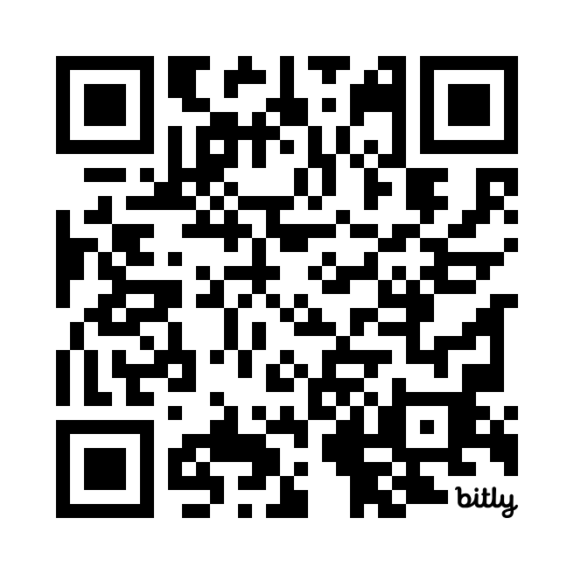
We need your input!
Tell us what you’d like to see in the next Level One website.
What resources do you need to design and build your IIPS?
URL:
bit.ly/L1Pwebsurvey
3

